Slide 1

Gotham
T-DIT-700 MSc2020
Gotham T-DIT-700

Slide 2
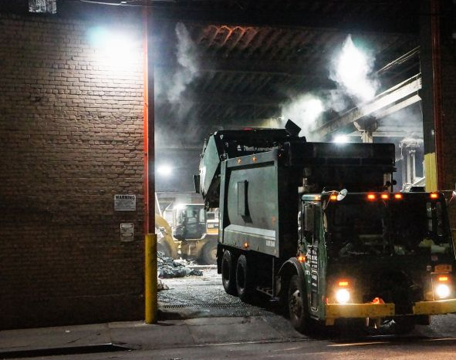
Summary 1. Introduction 2. Change Management 3. Mc Kinnsey Model / Leavitt diamond 4. Other tools 5. Conclusion

Slide 3
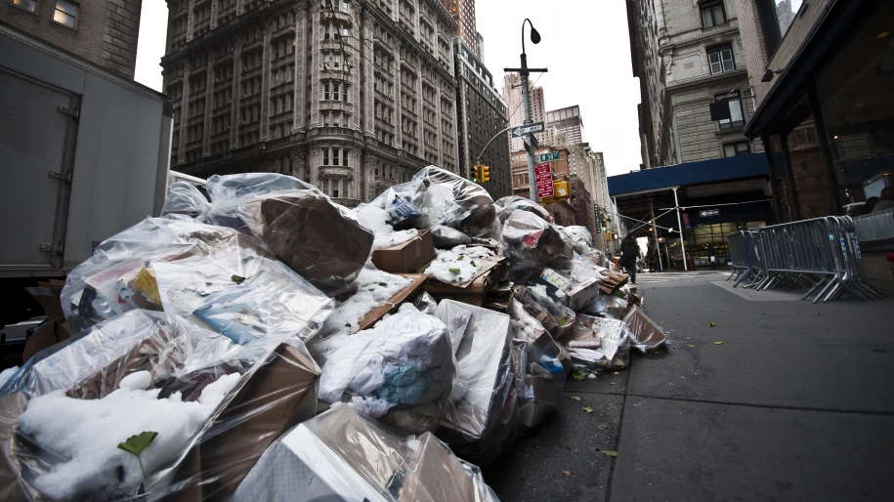
Introduction
The city hall has decided to implement a vast change plan in order to renew and reorganize its garbage collection system.

Slide 4








Changes decided by the town hall
1- Use the working time app
2- Equip trucks with GPS
3 – Equip employees with electronic device
4 - Use drones to check the collections and the state of cleanliness of the streets
5 – Smart trashes, with sensor
6 – Public app for incident reporting
7 – Monthly performance reporting

Slide 6

Thank you for listening
Do you have questions ?

